Slide 1
Classifier-free Guidance
Diffusion Probabilistic Model
Le Thien Phuc Nguyen, Manh Nguyen, Kiet Pham

Slide 2
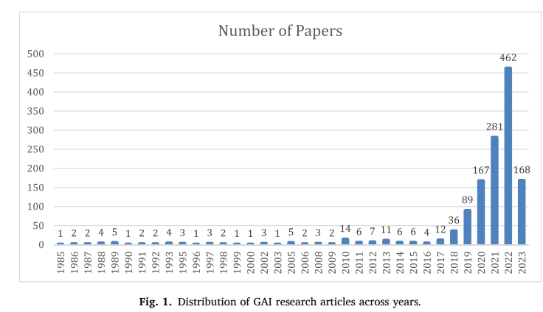
MOTIVATION
There has been an explosion in current trend of generative model ranging from GPT, VAE, GAN, diffusion model, and their variations.
Image from Gupta et al. (2024)
Notes:
Motivation + Introduction

Slide 3
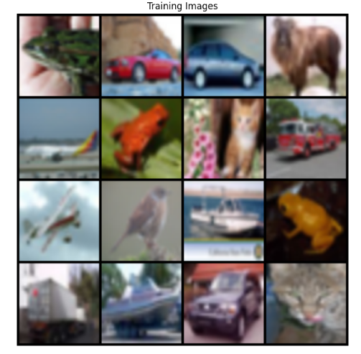
DATASET
Cifar 10:
10 classes: each class contains 5000 training images and 1000 test images
Low resolution: 64-by-64
Why Cifar 10?
Diffusion model is data hungry for small dataset
Low resolution images help save gpu’s vram

Slide 4
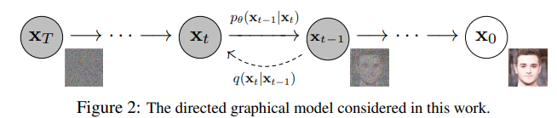
DIFFUSION MODEL
Originally adapted from an idea in non-equilibrium statistical physics by Sohl-Dickstein et al. (2015)
Forward: slowly adding noise to transform into a simple and tractable distribution (Gaussian or Binomial distribution).
Backward: Starting from the final state of the forward stage, we will recover from the nextstate which also follows Gaussian (or Binomial) distribution.
Image from Ho et al. (2020)
Notes:
Brief Knowledge

Slide 5
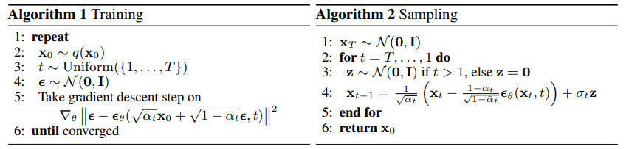
DIFFUSION MODEL
Ho et al (2020) came up with simple training and sampling algorithm for diffusion model:
Image from Ho et al. (2020)

Slide 6
Diffusion model
PyTorch implementation:

Slide 7
AUTOENCODER: UNET

Slide 8
TRAINING ARCHITECTURES
Dataset: https://www.cs.toronto.edu/~kriz/cifar-10-python.tar.gz
Image Size: 64 x 64
Batch Size: 28 x 28
Neural Network Model: UNet
Optimizer: ADAM
Learning Rate: 0.01
Diffusion Model
Exponential Moving Average:
β = 0.995
Notes:
Implementation

Slide 9
TRAINING PROGRESS
Notes:
Implementation

Slide 10
RESULTS
Notes:
Result

Slide 11
Notes:
Discussion

Slide 12
REFERENCES
Sohl-Dickstein, J., Weiss, E., Maheswaranathan, N., & Ganguli, S. (2015, June). Deep unsupervised learning using nonequilibrium thermodynamics. In International conference on machine learning (pp. 2256-2265). PMLR.
Ho, J., Jain, A., & Abbeel, P. (2020). Denoising diffusion probabilistic models. Advances in neural information processing systems, 33, 6840-6851.
Nichol, A. Q., & Dhariwal, P. (2021, July). Improved denoising diffusion probabilistic models. In International conference on machine learning (pp. 8162-8171). PMLR.
Ho, J., & Salimans, T. (2022). Classifier-free diffusion guidance. arXiv preprint arXiv:2207.12598.
Dhariwal, P., & Nichol, A. (2021). Diffusion models beat gans on image synthesis. Advances in neural information processing systems, 34, 8780-8794.

